Slide 1

Lab 04 pwm
Prof. Davide Brunelli
Dept. of Industrial Engineering – DII
University of Trento, Italy
davide.brunelli@unitn.it

Slide 2
ACTIVITIES
pwm

Slide 3
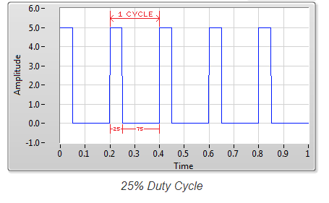
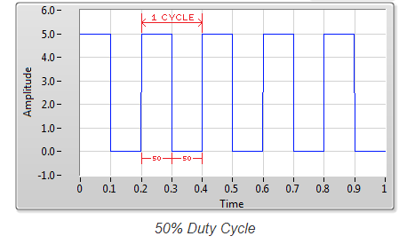
PWM
A Pulse Width Modulation (PWM) Signal is a method for generating an analog signal using a digital source. A PWM signal consists of two main components that define its behavior: a duty cycle and a frequency. The duty cycle describes the amount of time the signal is in a high (on) state as a percentage of the total time it takes to complete one cycle.
The frequency determines how fast the PWM completes a cycle (i.e. 1000 Hz would be 1000 cycles per second), and therefore how fast it switches between high and low states. By cycling a digital signal off and on at a fast enough rate, and with a certain duty cycle, the output will appear to behave like a constant voltage analog signal when providing power to devices.
3

Slide 4
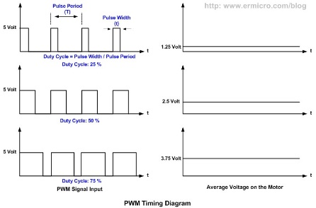
PWM
Example: To create a 3V signal given a digital source that can be either high (on) at 5V, or low (off) at 0V, you can use PWM with a duty cycle of 60% which outputs 5V 60% of the time. If the digital signal is cycled fast enough, then the voltage seen at the output appears to be the average voltage.
If the digital low is 0V (which is usually the case) then the average voltage can be calculated by taking the digital high voltage multiplied by the duty cycle, or 5V x 0.6 = 3V. Selecting a duty cycle of 50% would yield 2.5V, 25% would yield 1.25V, and so on.
4

Slide 5
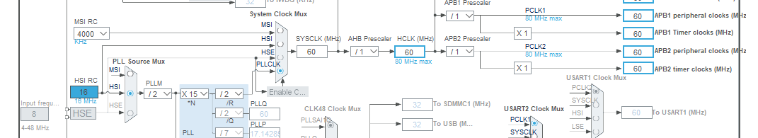
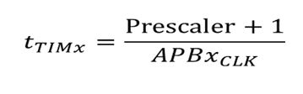
STM32 Timers
Timer tick time (or timer resolution) is base on APBx clock. It can be scaled using a 16 Bit prescaler. We can modify the base clock, to simplify the pre-scaler division.
5

Slide 6
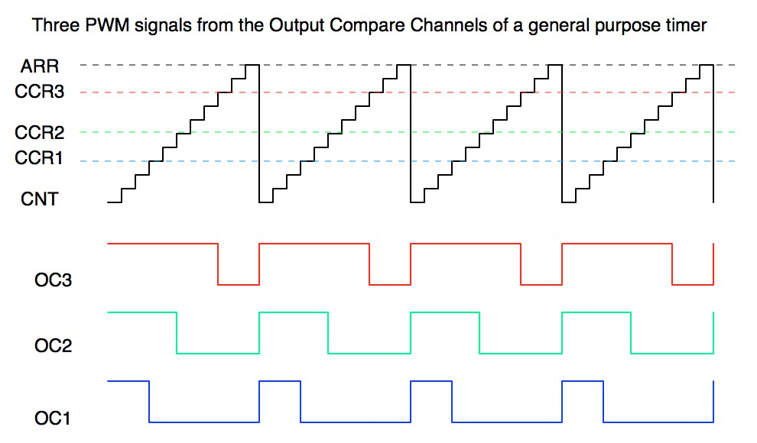
STM32 Timers – PWM
The output pin is cleared whenever there is a match between the CCRx and the CNT registers and then set again when the counter reloads.
6

Slide 7
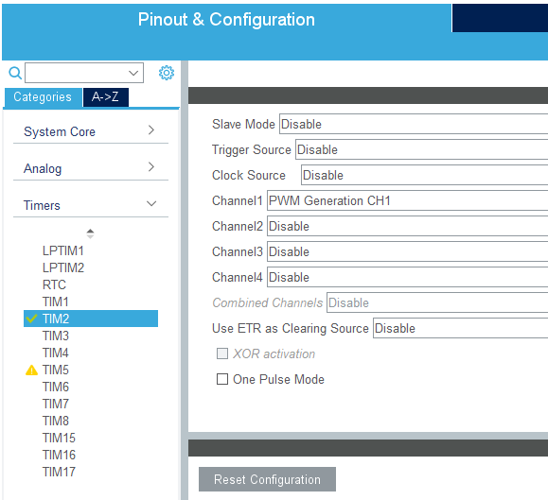
STM32 Timers – PWM
As previously said, the F4 MCUs have different timers, with a range of functions. Some of them are able to generate a PWM signal
We can use TIM2 to generate a PWM signal.
Moreover, we can directly connect the signal generated by the timer to a specific channel (i.e. GPIO)
7

Slide 8
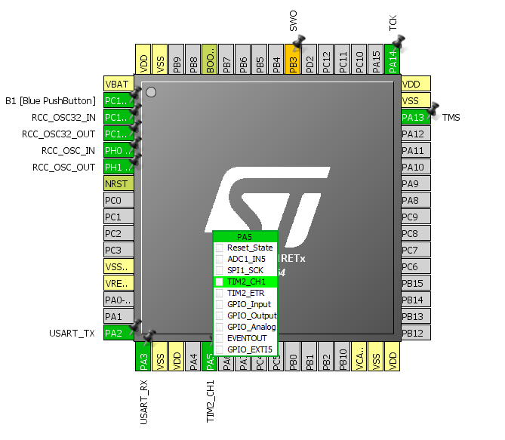
STM32 Timers – PWM
PA5, the GPIO associated to the green LED, can be connected to Channel 1 of TIM2.
In this way, we can drive the green LED using the PWM signal generated by the timer.
8

Slide 9
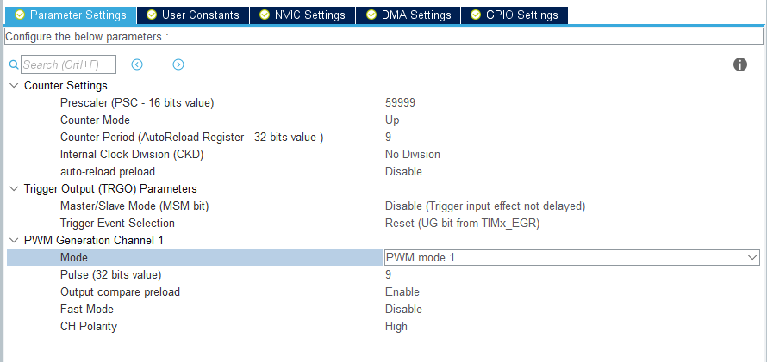
STM32 Timers – PWM
Click on TIM2 configuration. Set the Prescaler value equal to 59999 and a Counter Period value equal to 9 (to achieve ~10 mS).
Under PWM Gen. Channel 1, set Pulse equal to 9
9

Slide 10
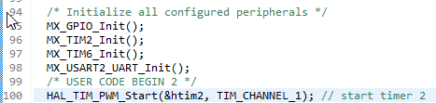
STM32 Timers – PWM
After the configurations are done using CubeMX, we can regenerate the code and open it using System Workbench. Then, we just have to start the timer in PWM mode
10

Slide 11
Exercise 4
Change the duty cycle dynamically

Slide 12
Change the duty cycle dynamically
Use the previously configured timer to generate a PWM signal to drive the LED.
Use CubeMX to configure a timer which can generate a PWM
Configure the timer as previously shown
Enable an interrupt for the blue pushbutton
Using proper callbacks, modify the duty cycle of the PWM when the button is pressed
(To modify the duty cycle: TIM2 -> CCR1 .
Remember to restart the timer after this change each time.)
12

Slide 13
Exercise 5
Fading led through pwm

Slide 14
Fading led through pwm
Use the previously configured timer to generate a PWM signal to fade the LED.
Use CubeMX to configure a timer which can generate a PWM
Configure the timer as previously shown
Using the proper callback, cycle the duty cycle of the PWM to get a fading effect of the LED, i.e. increase gradually the PWM duty cycle up to a maximum and then decrease it down to a minimum and keep repeating this loop.
(To modify the duty cycle: TIM2 -> CCR1 .
Remember to restart the timer after this change each time.)
14

Slide 15
Exercise 6
Fading led through pwm with interrupts

Slide 16
Led fading with pwm using interrupts
Use a second timer to drive the fading generated by the previously configured timer.
Use CubeMX to configure a second timer
Using the callback of the second timer, cycle the duty cycle of the PWM to get a fading effect of the LED, i.e. increase gradually the PWM duty cycle up to a maximum and then decrease it down to a minimum and keep repeating this loop.
(To modify the duty cycle: TIM2 -> CCR1 .
Remember to restart the timer after this change each time.)
16

